Slide 1
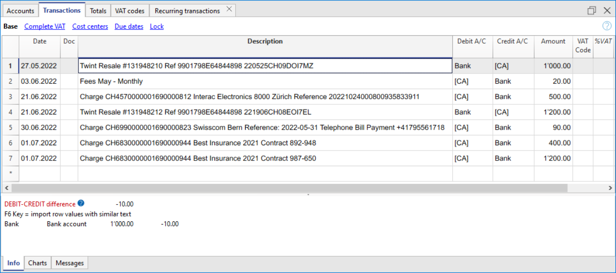
Twint Resale #131948210 Ref 9901798E64844898 220525CH09DOI7MZ
❷
❸
❹
❺
❶
❶
Fees May - Monthly
Charge CH4570000001690000812 Interac Electronics 8000 Zürich Reference 20221024000893583
Twint Resale #131948212 Ref 9901798E64844992 220619CH08EOI7EL
Charge CH6990000001690000823 Swisscom Bern Reference: 2022-05-31 Telephone +41795561718
Charge CH6830000001690000944 Best Insurance 2021 Contract 892-948
Charge CH6830000001690000944 Best Insurance 2021 Contract 987-650

Slide 2
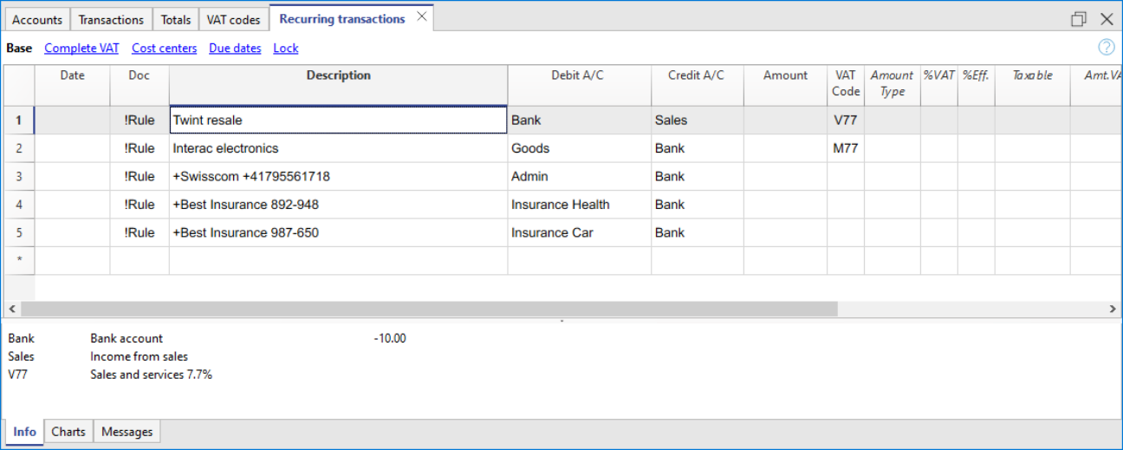
❶
❷
❸
❹
❺

Slide 3
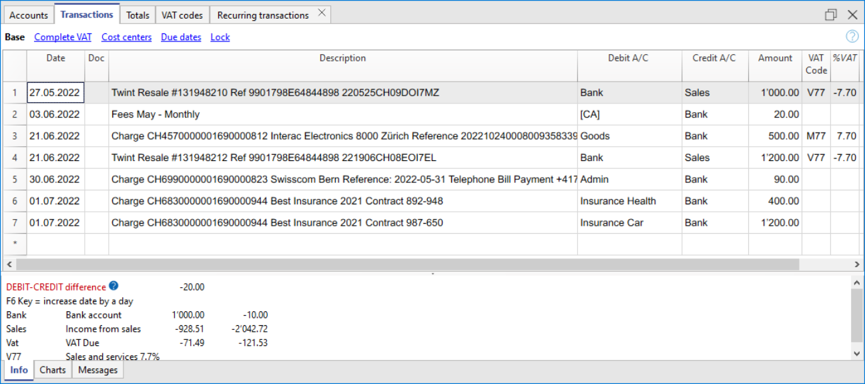
❷
❸
❹
❺
❶
❶

